Slide 1


CHATGTP
Friend or Foe?
Dave Andren, City of McAlester

Slide 2



CONTENTS
1
What is ChatGTP? and what it is not...
2
How you can use Chat GPT daily
3
Challenges/pitfalls using ChatGTP

Slide 3



1
What is Chatgtp?

Slide 4


4
what is Chatgtp?
THINK MORE JARVIS

Slide 5

4
what is Chatgtp?
AND LESS TERMINATOR

Slide 6



1
What is Chatgtp?
  ChatGPT is an AI language model developed by OpenAI.
  It's designed for natural language conversations.
  Trained on a large dataset of text.
  Can generate human-like text in a conversational manner.
  Used in chatbots, virtual assistants, customer support, and more.
  Valuable for automating text-based interactions.
  Evolves with improved versions over time.

Slide 7

What Chatgtp is not...

Slide 8
what Chatgtp is not...
IT WILL NOT COOK FOR YOU, OR MAKE COFFEE, OR CLEAN UP YOUR MESS...

Slide 9
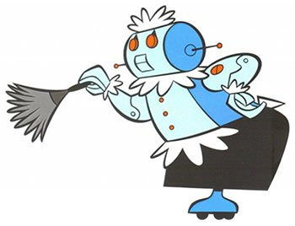
what Chatgtp is not...
THAT DOES NOT COMPUTE...!

Slide 10
2
what are some Daily uses for chatgtp?

Slide 11
2
Daily uses for chatgtp?
professional email responses
How much time do you spend answering Email?

Slide 12
2
Daily uses for chatgtp?
professional email responses
How much time do you spend answering Email?
customer communications
Take some of the pain out of PR and public releases

Slide 13
2
Daily uses for chatgtp?
professional email responses
How much time do you spend answering Email?
customer communications
Take some of the pain out of PR and public releases
Job Descriptions, Letters of Reprimand/Terminations, new policies and procedures?
Human Resources

Slide 14
2
Daily uses for chatgtp?
professional email responses
How much time do you spend answering Email?
customer communications
Take some of the pain out of PR and public releases
Job Descriptions, Letters of Reprimand/Terminations, new policies and procedures?
Human Resources
Policy analysis
Worried about how your policies stack up to DEI?

Slide 15
What Chatgtp is not...

Slide 16
what Chatgtp is not...
A SELF-AWARE AI THAT IS HELL BENT ON WORLD DOMINATION AND SUBJUGATING HUMANITY TO EXIST AS BATTERIES, WHILE LIVING IN A VIRTUAL WORLD...

Slide 17
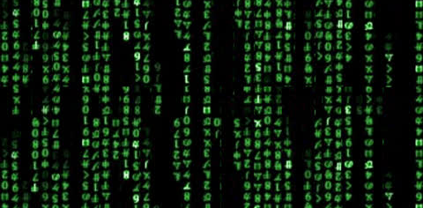
what Chatgtp is not...
WHAT IS REAL...?

Slide 18
How can Chatgpt help with email?

Slide 19


2
how chatgtp can help with email
Summarize
When you get those really long diatribe emails from “that guy”...
Summarize it!

Slide 20
2
how chatgtp can help with email
Summarize
in chatgtp...
When you get those really long diatribe emails from “that guy”...
Summarize it!
Summarize the following email in bullet point format, highlighting the needs to the community and cost to the city. (copy and paste)

Slide 21
2
how chatgtp can help with email
respond
When you get those awesome sales reps repeatedly asking for a demo or meeting...

Slide 22
2
how chatgtp can help with email
Respond
in chatgtp...
When you get those awesome sales reps repeatedly asking for a demo or meeting...
Reply to the following email with a polite no. (copy and paste)

Slide 23
2
how chatgtp can help with email
Compose
When you have to write those Emails to all employees, and you rewrite it over and over... ughh...

Slide 24
2
how chatgtp can help with email
Compose
in chatgtp...
Compose an email to all City of McAlester employees wishing a happy holiday them ask them to be safe and make smart decisions
When you have to write those Emails to all employees, and you rewrite it over and over... ughh...

Slide 25
What Chatgtp is not...

Slide 26
what Chatgtp is not...
A LONELY TRASH COMPACTOR THAT HAS AN AFFINITY FOR BARBARA STREISAND MOVIES AND SMITTEN BY A SLEEK, FLOATING, RECON PROBE...

Slide 27
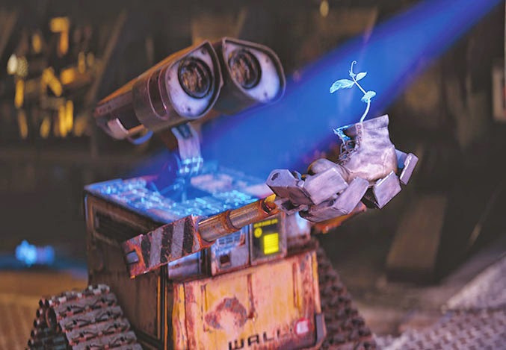
what Chatgtp is not...
EVE...!

Slide 28
How can Chatgpt help with messaging

Slide 29
how chatgtp can help with Messaging
2
Correspondence
When you have to write notifications to your customers...

Slide 30
how chatgtp can help with Messaging
2
Correspondence
in chatgtp...
Write a short message informing the citizens of McAlester of a 3% rate increase on water and sewer rates, base on CPI
When you have to write notifications to your customers...

Slide 31
how chatgtp can help with Messaging
2
Correspondence
When you need to prepare the public for a change in management of your Water Treatment Facility...

Slide 32
how chatgtp can help with Messaging
2
Correspondence
in chatgtp...
Write a short message informing the citizens of McAlester that city employees will take control the Water Treatment Plant from Inframark on July 1st, 2024. Inframark has been operating the plant for the last 9 years.
When you need to prepare the public for a change in management of your Water Treatment Facility...

Slide 33
how chatgtp can help with Messaging
2
Correspondence (Follow-on)
Now you want to create a press release about the Water Treatment Plant for the paper

Slide 34
how chatgtp can help with Messaging
2
Correspondence (Follow-on)
in chatgtp...
Now you want to create a press release about the Water Treatment Plant for the paper
Take that message and write a short press release for the local news

Slide 35
how chatgtp can help with Messaging
2
for External agencies
The local newspaper reporter wants a comment about the new airport terminal building ...

Slide 36
how chatgtp can help with Messaging
2
for External agencies
in chatgtp...
Write a short comment for the newspaper about the new Airport Terminal and the opportunities for economic development and showcasing the partnership with the Choctaw Nation’s unmanned aerial vehicle program.
The local newspaper reporter wants a comment about the new airport terminal building ...

Slide 37
how chatgtp can help with Messaging
2
"I am thrilled to witness the realization of our new airport terminal building, a beacon of progress that propels McAlester into a new era of economic development. This cutting-edge facility not only enhances our region's connectivity but also signifies a pivotal step forward in advancing opportunities within the aviation industry. I am particularly excited about the collaborative efforts with the Choctaw Nation, which holds immense potential, especially in fostering the growth of unmanned aerial vehicle programs. Together, we are charting a course towards a future where innovation, economic prosperity, and community development take flight."

Slide 38
What Chatgtp is not...

Slide 39
what Chatgtp is not...
A GAMING SIMULATION THAT CAN ACCESS THE NUCLEAR LAUNCH CODES BUT JUST WANTS TO PLAY A GAME OF TIC-TAC-TOE...

Slide 40

what Chatgtp is not...
SHALL WE PLAY A GAME...?

Slide 41
How can Chatgpt help with Human Resources

Slide 42
how chatgtp can help with Human Resources
2
for writing Job Descriptions
When you want to hire a GIS Technician, a position that is new to the city, start with writing a Job Description for the new post

Slide 43
how chatgtp can help with human resources
2
for writing Job Descriptions
in chatgtp...
Using the following a template [copy and paste an existing job description], Write a job description for a GIS Technician, require 5 to 7 years of experience with ArcGIS online
When you want to hire a GIS Technician, a position that is new to the city, start with writing a Job Description for the new post

Slide 44
how chatgtp can help with Human Resources
2
Follow-on - Job Advertisements
Now you now need to write a job advertisement.

Slide 45
how chatgtp can help with Human Resources
2
Follow-on - Job Advertisements
in chatgtp...
Now you now need to write a job advertisement.
Take that job description and write a job advertisement

Slide 46
how chatgtp can help with Human Resources
2
Letters of Reprimand
Have an employeee that needs an official reprimand? Have Chat GTP work on the letter!

Slide 47
how chatgtp can help with Human Resources
2
Letters of Reprimand
in chatgtp...
Write a Letter of Reprimand to Bilbo Baggins for repeated tardiness and poor attitude towards his supervisor, Gandolf the Gray
Have an employeee that needs an official reprimand? Have Chat GTP work on the letter!

Slide 48
2
how chatgtp can help with Human Resources
Write a a Policy for the City of {insert City} that requires Comp Time to be used at the pay rate it was earned. Employees must used their comp time before recieving a promotion, Merit increase or COLA increase.
New Policies
Review the following Policy for DEI&A: {paste policy verbage}
Policy analysis

Slide 49
What Chatgtp is not...

Slide 50
what Chatgtp is not...
A SPACESHIP CONTROL AI THAT HAS A MURDEROUS WAY OF DEALING WITH CONFLICTING ORDERS... I CANNOT LIE, SO I WILL JUST KILL THEM ALL...

Slide 51

what Chatgtp is not...
WHAT ARE YOU DOING DAVE...?
DAISY...

Slide 52
potential Challenges and pitfalls of Chatgtp

Slide 53


4
potential problems
SUBJECT TO OPEN RECORDS?
PRESENTATION WITHOUT VALIDATION

Slide 54
3
potential problems
Subject to open records?
  Chat GTP has not been challenged in the courts for Open Records Act , but it is only a matter of time
  Can be viewed as “Working Papers” in the preparation of documents. Those would be subject to open records
  What about preparation of personnel actions? How do you protect Personally Identifiable Information?

Slide 55
3
potential problems
Presentation without validation
  Using Chat GTP can have disasterous consequences if we don’t validate the data that it is providing.
  While it is a useful tool to make our lives a little easier, we have to take the time to make sure that the information it produces is relevant and correct.

Slide 56

4
potential problems
DEPENDENCE ON TECHNOLOGY
PRIVACY AND DATA CONCERNS

Slide 57
3
potential problems
dependance on technology
  Chat GTP has the ability to make easy work of some of our most mundane tasks, time-killers, when we become to reliant on it, it can create a tunnel vision.
  We can easily lose focus on our other core competencies when we give up these tasks to a machine.
  This dependency can lead us down a path that can prematurely lead to lay-offs or rewriting our job descriptions, these tasks must remain in our skill inventory

Slide 58
3
potential problems
Privacy and Data concerns
  ChatGTP is open source, it is free to the world, and so it EVERYTHING you put in it.
  You must protect the data that you provide it
    Never use names! Never use PII!
  Consider the details that you are giving it, if the subject matter is sensitive in nature, can the small details lead to an inadvertent release of confidential data?

Slide 59
What Chatgtp is not...

Slide 60
what Chatgtp is not...
A DIABOLICAL AI MACHINE THAT SEES THE ANNIHILATION OF THE HUMAN RACE AS THE ONLY MEANS OF SURVIVAL...

Slide 61
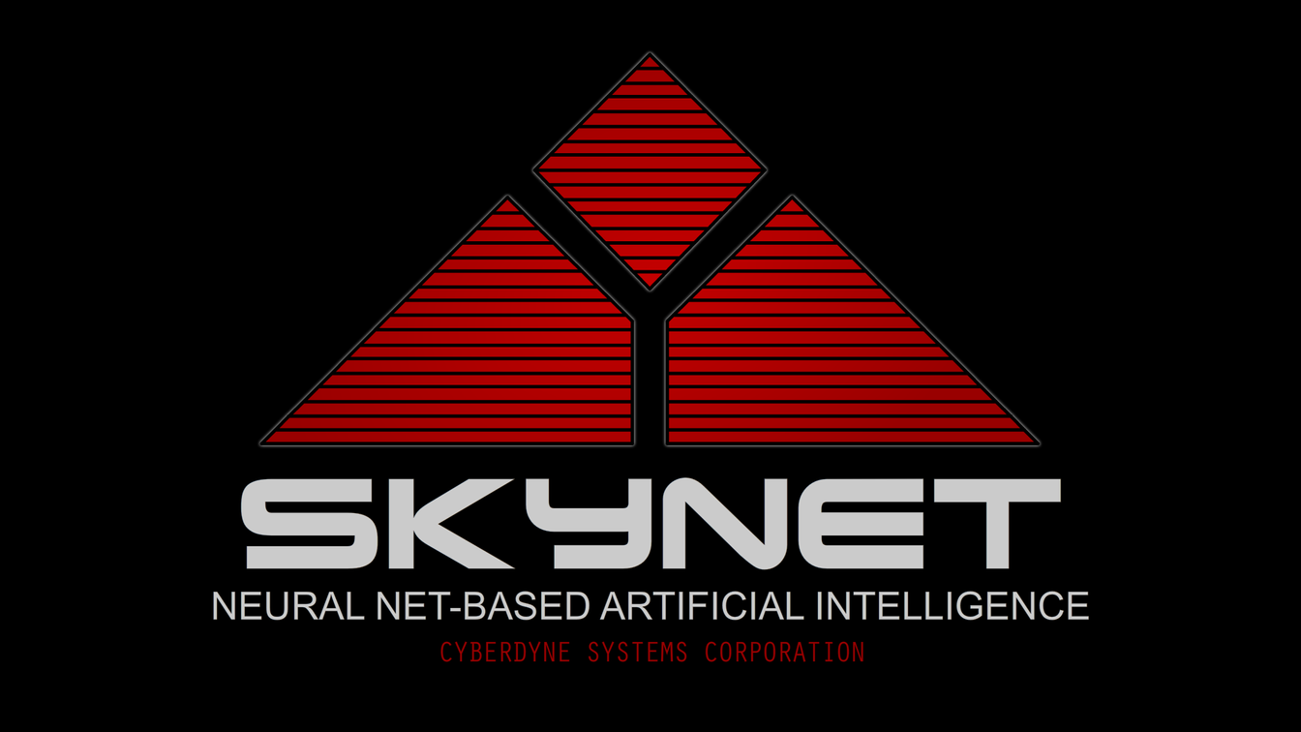
what Chatgtp is not...
I’LL BE BACK...

Slide 62
CHATGTP
Friend or Foe?
Any questions?

Slide 63









RESOURCES

