Slide 1
PURCHASING

Slide 2
1. We make decisions every day that affects the bottom line.
And now more than ever, it’s imperative that we go the extra step to capitalize on any opportunities that may be available to us.

Slide 3
For the next hour we are going to talk about
A. Current Purchasing climate and Issues.
B. Some of the Underlying factors that are fueling these issues
C. Processes and Procedures that must be in place for the organization to be successful
D. And Solutions if implemented, will produce some purchasing efficiencies

Slide 4
The Perfect Storm

Slide 5
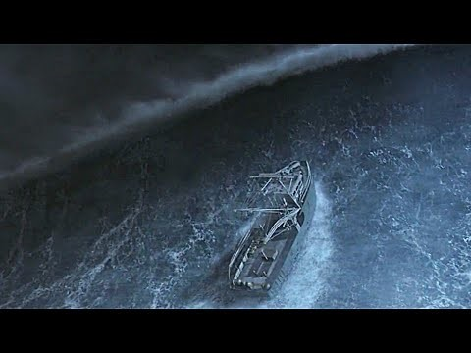

Slide 6
What are some of the main factors that have influenced or contributed to the overall purchasing climate we are now experiencing ?

Slide 7
Three Major issues
1. INFLATION: High consumer demand in the economy -- met with low supply.

Slide 8
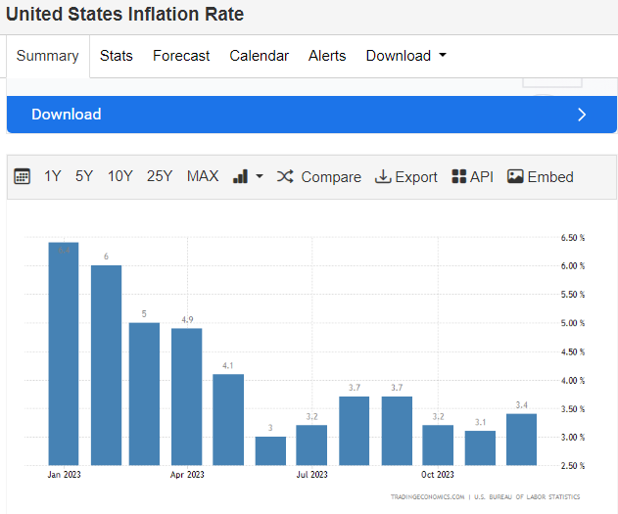

Slide 9
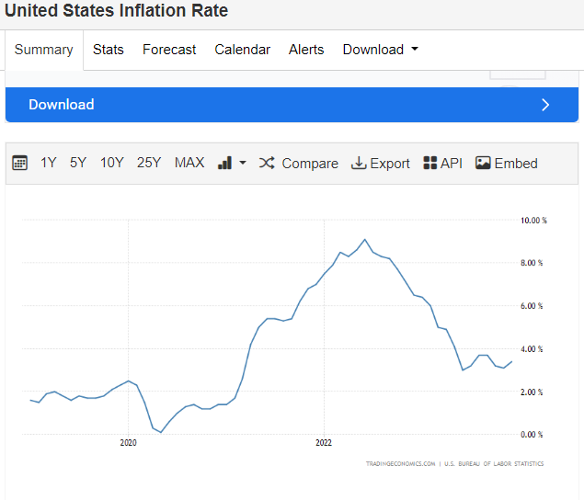

Slide 10
Three Major issues
2. SUPPLY CHAIN:
A. Logistic disruption
B. Production delays
C. Over reliance on limited number of third parties and foreign countries.
D. Technology Investment

Slide 11
Three Major issues
2. SUPPLY CHAIN:
E. Commodity Pricing
F. Workforce and Labor

Slide 12
Three Major issues
3. CAPITALISM: An economic and political system in which a country's trade and industry are controlled by private owners for profit:
The Question is, Do you think that the price increase we are currently seeing is still due to supply chain issues or suppliers trying to capitalize on the situation?

Slide 13
Current Issues Your Municipality May be Dealing With in reference to Purchasing

Slide 14
1. Supply Chain Issues
2. A 30 - 60% increase in prices over the last few years.
Fund Balance
Budget Amendments
Borrowing Money
Interest rates
Leasing as oppose to purchasing

Slide 15
The pressure to increase or decrease Utility rates.
Debt Ratio to high
Federal funding sources such as ARPA funds etc., are no longer available
Where do you find the additional dollars?

Slide 16
All those questions are coming from the Department Head Level or higher.
What about the other questions like,

Slide 17
The Other Questions
1. How did we pay the wrong vendor?
2. Late Fees?
3. We paid the Same invoice Twice?
4. Who should get a 1099?

Slide 18
The Other Questions
5. Partial Payment Process
6. Why are we paying taxes?
7. The invoice was sent to the finance directors email, city clerks email, AP email, and the Payroll email every month.

Slide 19
What’s the answer to those questions?

Slide 20
1. Make sure you have A Purchasing policy.

Slide 21
The Purchasing Policy should address issues like,
1. The department responsibilities
2. Purchasing parameters
3. Purchasing Procedure Violations

Slide 22
4. The Competitive Bidding Process
5. Exceptions to Competitive Bidding
Emergency Purchases
Sole Source Purchases

Slide 23
6. Explore alternatives to the State approved Vender List by becoming a member of public cooperative such as Sourcewell/NJPA.
(National Joint Powers Alliance)

Slide 24
Sourcewell is a public cooperative agency that provides contract purchasing solutions, professional development and other services to government, education and nonprofit organizations
Sourcewell helps its members save time and money by offering pre-negotiated pricing and competitive contracts.

Slide 25
Other Cooperatives are
1. NPPGov
2. HGHC Buy
3. Buy Board

Slide 26
7. Bulk Purchase
8. Janitorial supply
9. Paper
10. General Supplies

Slide 27
11. Leasing as oppose to Buying
12. Accounting Software Upgrade
13. Automate the Purchasing process

Slide 28
14.
Reduce manual accounting work: Manually managing the procurement and accounting process is expensive and inefficient.
Errors in accounts payable processes result in extra fees, double payments, and the loss of early payment discounts.
Reduce manual data entry and processing to drop your per-invoice accounting cost and save valuable overhead.

Slide 29
15. Scrub your vendor list Every year
16. W-9 and Liability Insurance.
17. Leverage Volume Discounts.

Slide 30
18. Be cognizance of state laws
19. Don’t be tempted to operate out side the boundaries.
20. Always make sure you consult with your attorney on issues that are considered out of the box.

Slide 31
21. Disposal of surplus property
22. Cooperative Procurement

Slide 32
Questions?

