Slide 1
CMAO POLICY CREATION/MANAGEMENT January 24, 2024
https://youtu.be/BM3T-nQvu5E
Notes:
.

Slide 2
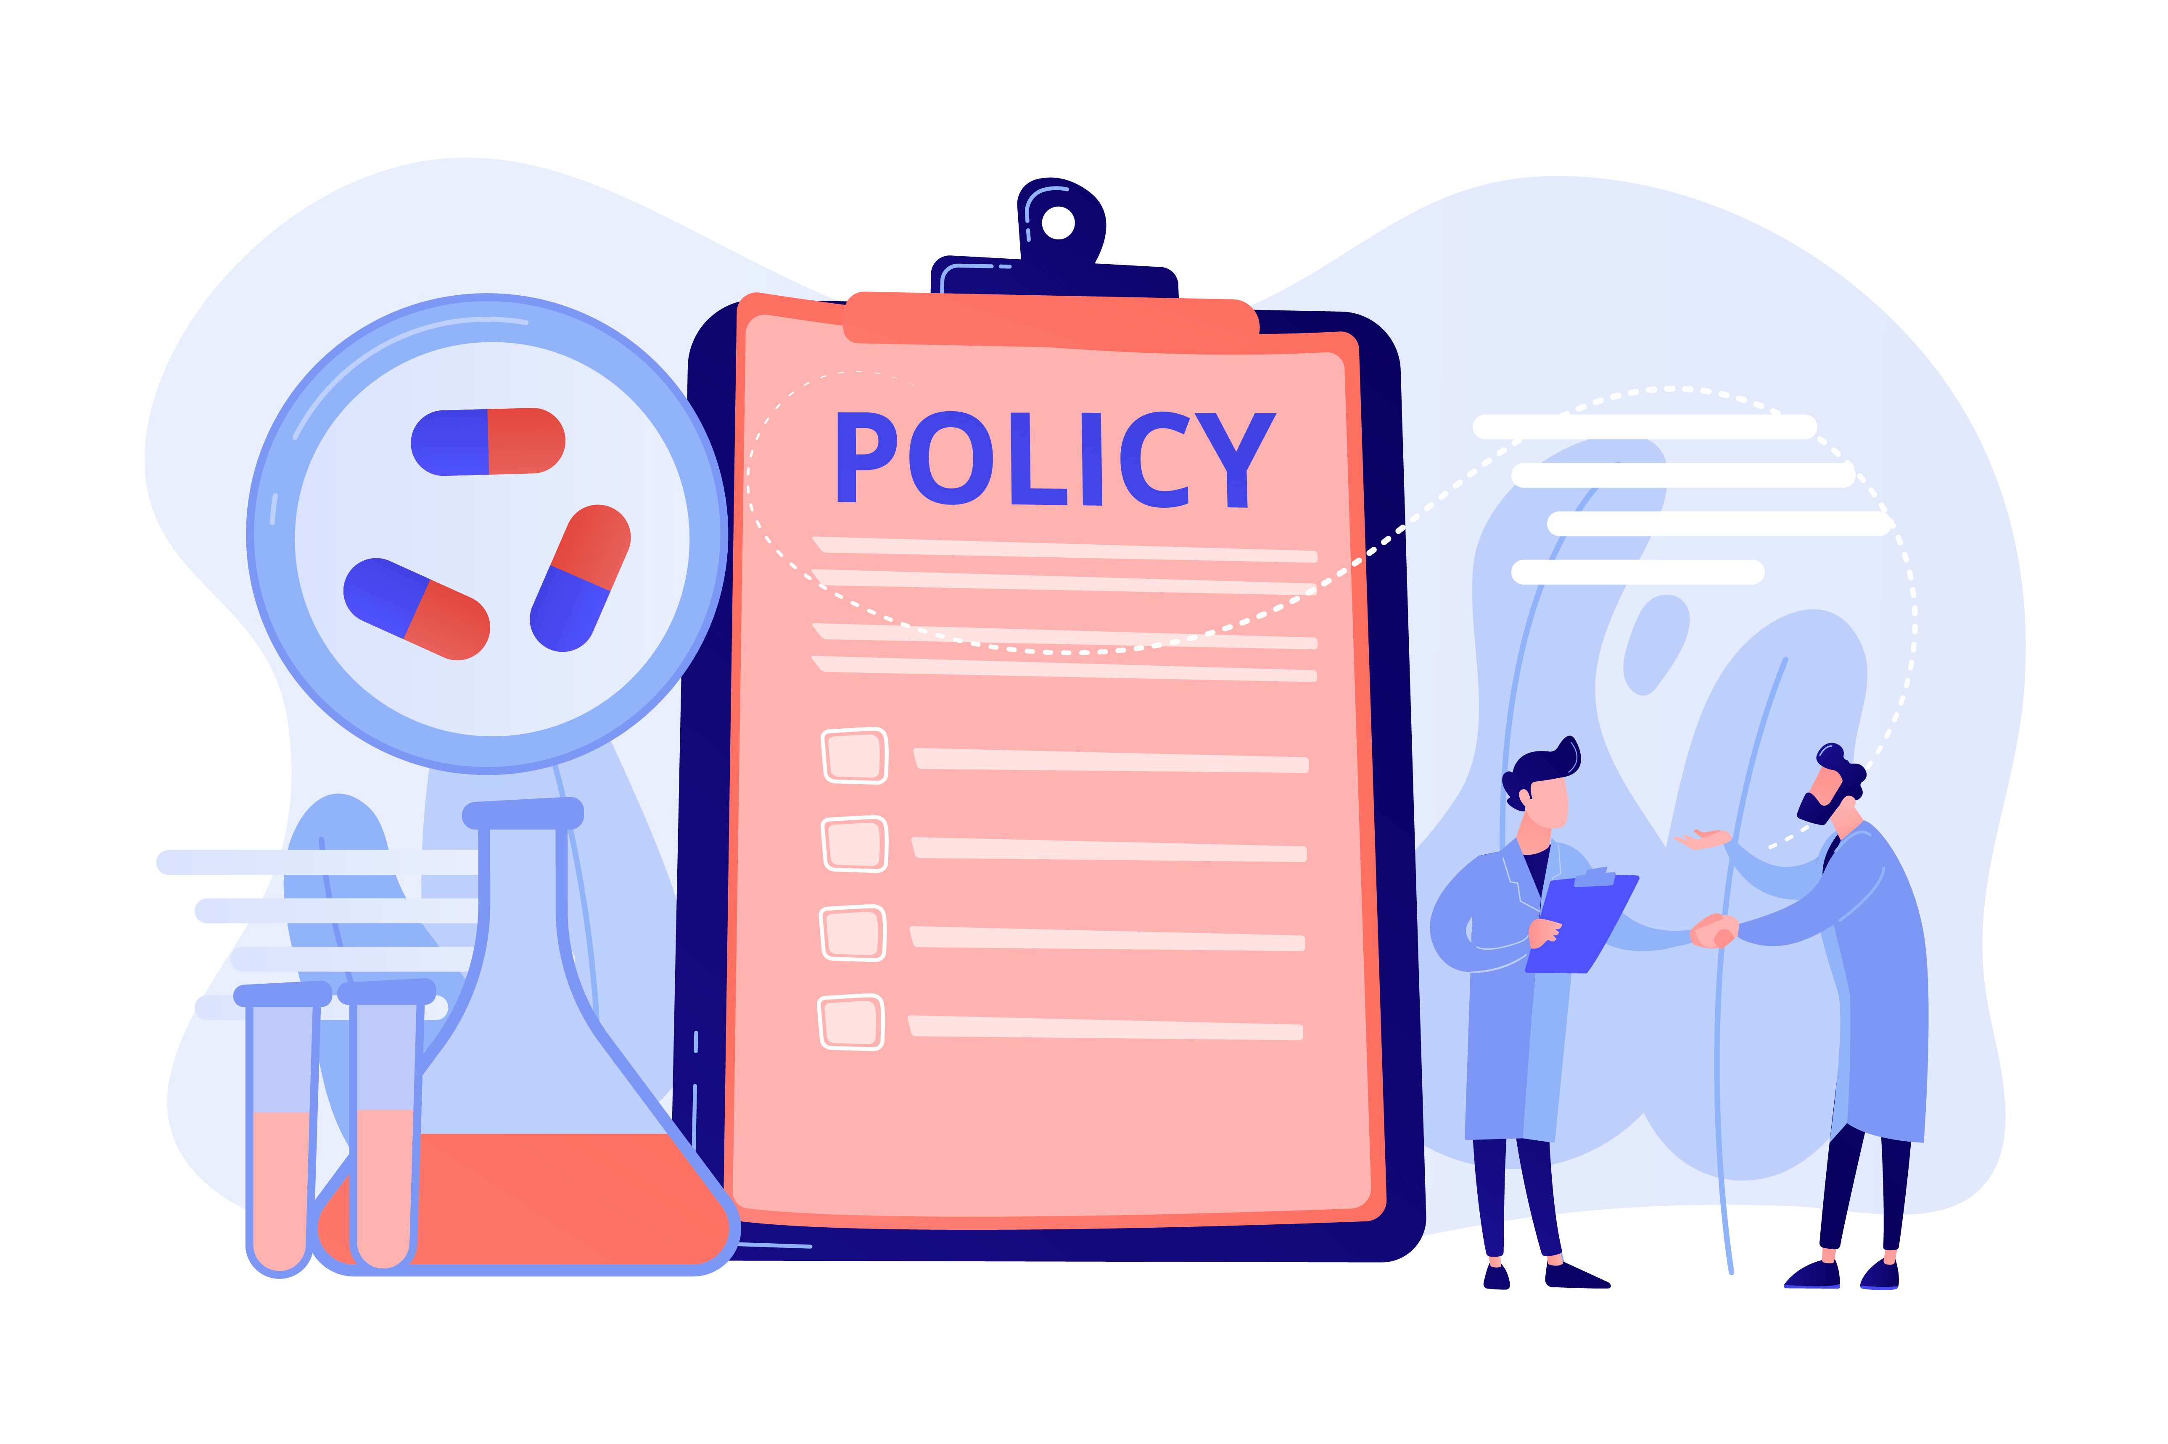
POLICY DEFINITION
A course or principle of action adopted or proposed by a government, party, business, or individual.
Guidance on how to conduct our city business

Slide 3
POLICY ORIGINATION
US Constitution
Federal and state laws
Federal and state rule promulgators
EPA, HUD, DOE
DEQ, OWRB, DOC
Ordinances which are the municipal laws codified into your municipal code
Policies are created to provide clear guidance and help effectively administer and execute municipal ordinances

Slide 4
POLICY PURPOSE
Explains how to handle certain municipal business
Solves or resolves problems or issues; reduces conflict
Communicates how the city goes about conducting municipal business with both employees, the public, and organizations
Provides consistent answers regardless of the employee following the policy. Once a policy is documented, it is easier to modify to solve new problems or issues in the future
Procedures and processes are further ways to document/implement/administer and execute policies

Slide 5
POLICY CHARACTERISTICS
Written or unwritten
Less is better or less is more; depends on complexity
Typically created by city employees, consultants or other related organizations
Provides guidance on how to solve or resolve future requirements
Approved by councils, city managers, and staff themselves
Do not and can not cover every conceivable situation

Slide 6
POLICY EXAMPLES
Commission handbook
Resolution on commission meeting rules
Comprehensive plan
Personnel manual
Trust indentures
Bylaws
Library board policies

Slide 7
POLICY ASSISTANCE
CMAO
Contact for assistance; search document database
OMAG
Insurance, Legal, Best Practices
OML
Legislative, Best Practices, Legal
Your staff experts
Your city attorney

Slide 8
NAZIS, DIRTY BOOKS, POT-BELLIED PIGS AND BOARD COUPS
Issues that have arisen over the past several years
Used policy to help us address the issues
Some have been divisive
People actually talk about this stuff in public comments
Comments driven by passion and belief
Not the kind of public media coverage you want to highlight

Slide 9
COUNCIL ELECTIONS AND RECALLS
COVID accentuated extremes
COVID divisions worsened right and left extremism
One group worked to recall a commissioner on the “left”
First recall effort ultimately failed
Groups became active in elections process and campaigning

Slide 10
COUNCIL ELECTIONS AND RECALLS
One of the commissioners that was elected in 2023 had allegedly marched in right wing extremist rallies and allegedly belonged to white nationalist groups
Constant commenting in public meetings
Led to recall effort by perceived “left” group
Council considered a censure resolution
Recall resolution passed with election called for April 2
At least one opponent has announced; filing period 29-31 Jan
Policy leads to ability of the people to redress wrongs or perceived wrongs and elect their representative

Slide 11
NEWTON’S THIRD LAW OF MOTION
For every action there is an equal and opposite reaction
Newton’s law applies to municipal dynamics as well as physics
Council updates meeting rules by resolution
Council tables censure
Council votes to set recall election date

Slide 12
LIBRARY ISSUES
During COVID, focus on computer networking, connections, remote learning and program software
Zoom, YouTube, and Google Classroom became prevalent
Also, social media outreach and digital programs were enhanced
Home learning was prevalent and homeschooling increased
National societal issues flared and became local issues at our library

Slide 13
LIBRARY ISSUES
Issues such as LGBTQ, sexually explicit material, violence, racial, religious and political
Employee turnover higher to include the library director
Difficult to find library directors or deputy directors, especially with a Masters in Library Science or in Library and Information Science
Newer, younger employees empowered with new digital outreach software

Slide 14
LIBRARY BOARD
Seven members appointed by the city commission
Given five specific responsibilities by ordinance
First task they decide to take on is to rewrite library policies to resolve problem or perceived problem
They meet every other month so progress is slow
Friction between extremes on the left and right create divisiveness
Difficult to work with the board

Slide 15
LIBRARY BOARD RESPONSIBILITIES
The duties of the Library Board are set out in Enid Municipal Code 2014, § 7-10-5. The duties include:
a. conducting hearings or meetings when needed;
b. an annual review of the library budget to include recommendations concerning expenditures and projects;
c. reviewing, developing, and adopting library policies that affect patrons, public service, and the availability of services for residents throughout Garfield County;

Slide 16
LIBRARY BOARD RESPONSIBILITIES
d. developing a long-term plan for the library, particularly as it relates to collection development, special programming, technology, infrastructure, and the library endowment fund;
e. making recommendations to the city manager concerning the hiring, performance, and retention of the Library Director.

Slide 17
LIBRARY POLICY CREATION/ADMINISTRATION
Staff worked with Library Board for approximately six months or so and adopted new polices in May of 2022
Board President rewrote policies and we worked through them
Require approval of library board four months in advance for library displays or exhibits
Library collection advisors to review proposed book purchase lists
Book challenges

Slide 18
APPLICATION OF POLICY AND RESULTS
Implemented written parental consent for all library programs for those under 18
Two library employees required for all teen and children programs
Library staff came up with Common Sense Media standard
Minors can only be enrolled by their parent (always the case)
Increased parental control to restrict adult materials as well as the internet
Communicate importance of choosing moderate candidates
Library board now balanced
Limited public comment both in council meetings and library board
Reduced a lot of unrest and divisiveness

Slide 19
CURRENT LIBRARY CHALLENGES
What is the young adult standard (12-18)?
Received 8 book challenges; moved 3 to the adult section, pending resolution on 5 book challenges
Staff morale-librarians make access to all kinds of materials from all genres
Update current young adult standard
They do not make like to make decisions about restricting access
Several board vacancies approaching

Slide 20
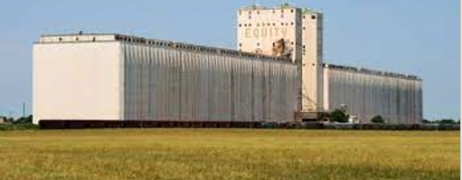
GROWTH REQUIRES CHANGE
Lengthy Site Plan Approval
Monthly Planning Commission meetings
Administration Approval in 2013
Problems with Silos

Slide 21
PROCESS IMPROVEMENT
Weekly Development Meetings
Pre-application meetings w/developers
Checklist of requirements given
Combined Department
Renovations
Community Outreach
Software

Slide 22
DEVELOPMENT CHALLENGES
Yesterday’s policies are not ready for tomorrow’s problems!
Research what others are doing
Don’t reinvent the wheel
Find what is right for your town
Listen to your contractors

Slide 23
POLICY CHANGE WORKS BEST WHEN WE ALLOW OTHERS TO EXPLAIN WHAT IS BROKEN
Problems with consistent application of fees
Various interpretation of ordinances – staffing changes
Too complicated

Slide 24
SPENDING THOSE TENSE MOMENTS TOGETHER CHANGED OUR POLICY, BUT EVEN BETTER THAN THAT, IT CHANGED AN ONGOING RELATIONSHIP
Who else can you listen to?
Board of Adjustment agendas
What issues keep surfacing?

Slide 25
GIVE YOUR MANAGER FLEXIBILITY
Code compliance on highway frontage
Give yourself another tool
Budget appropriations to solve miscellaneous issues
Show progress and promote cleanliness during public meetings
= Boosted confidence from the public and elected officials

Slide 26
PROTECTING VANCE’S AIRSPACE
MAPC approval of Use By Reviews for:
Energy Structures (windfarms and transmission lines)
Cell Phone towers

Slide 27
SOLAR FARM…NO PROBLEM
Went to MAPC as a Use By Review
There were emotions and “feelings”
Item was rejected

Slide 28
OUTDATED POLICY
1963
Some county property not zoned
Among others, Solar Farms not listed as a use by right
Agriculture zoning in the County does not have a Use By Review

Slide 29
PET PIGS
Not a hot issue
Covered by current ordinance
Constituent brings forth a desire to update the policy on pigs

Slide 30
TRUST INDENTURE AND BY-LAWS
Policy set a long time ago may need updated
Purpose of trust and history lost over time
Must educate and inform boards and employees

Slide 31
SUMMARY POLICY BEST PRACTICES
Keep the policies informative enough to be useful
Concise enough so that all your staff will read them
“Fix the flat tire; do not just keep adding air to the tire!”
Provide a solid framework for consistently solving problems or providing solutions
Give guidance that helps your staff at every level and the public to understand the municipal purpose of the policy
Keep those boards balanced
Limit public comment, have a timekeeper to assist the Mayor, and do not read social media

Slide 32
SUMMARY POLICY BEST PRACTICES
Reduce surprises
Use tactical patience

Slide 33
SUMMARY POLICY BEST PRACTICES
Focus on telling your municipal success stories early and often
Communicate constantly with the people about the positive efforts to make their lives better
Learn and adapt from the past
“You can please some of the people all of the time, you can please all of the people some of the time, but you can't please all of the people all of the time” Poet John Lydgate and Abraham Lincoln
“Ask not what your city can do for you; ask what you can do for your city” President John F. Kennedy

Slide 34
QUESTIONS

