Slide 1
ICMA Update and
Code of Ethics Review
11:00 a.m. January 24, 2024
Dave Slezickey
City of The Village, OK
ICMA Board Member/Mountain Plains VP
(405)368-3705
dave@thevillageok.gov
dslezickey@icma.org

Slide 2
Notes:
ICMA BoD MPVP
BOD 21 members 5 US regions and 1 Int region, and Pres trio; 3 year terms
BOD not a council

Slide 3
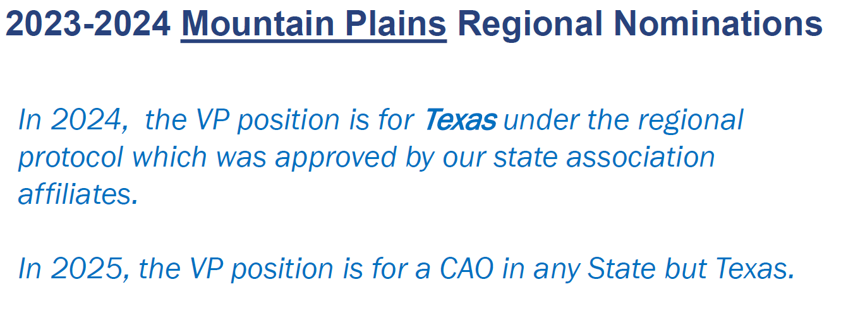
In 2026, the VP position is for a non-CAO in any State but Texas.
Notes:
Upcoming opportunities for service
Nomination Process

Slide 4
.
Notes:
Small city $85K salary
$110.50 discount reducing dues from $552 annual to $441.50
or $36.80 per month or just $1.21 per day

Slide 5
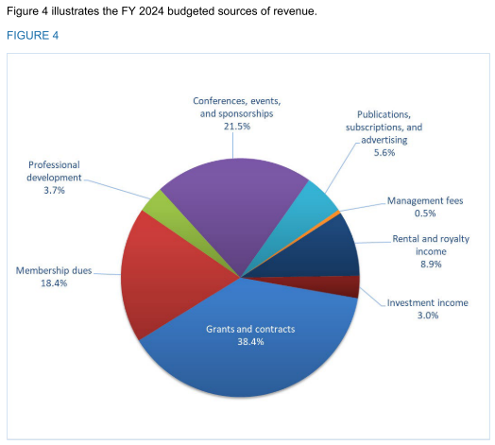
$31 million annual budget
19.8% 2023
Notes:
Global initiative Grants & Contracts
Dues reduced due to other increase reveneues
Not a dues based revenue organization

Slide 6
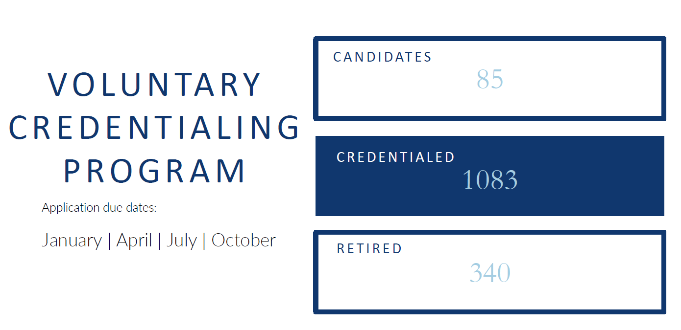
www.icma.org/icma-voluntary-credentialing-program
OKLAHOMA - 11
Mr. Mike Bailey, CPA (Mike), City Manager, City of Bartlesville
Mr. Shaun W Barnett (Shaun), City Manager, City of Woodward, (Candidate)
Mr. Dale Bunn, ICMA-CM, MBA, CPM (Dale), City Manager / Public Works General Manager, City of Purcell
Mr. John R. Dean, Jr., MPA, ICMA-CM (John), (Retired)
Mr. Jason B. Orr (Jason), City Manager, City of Chandler
Mr. Dave Slezickey, MBA, ICMA-CM (Dave), City Manager, City of the Village
Mr. Carl J. Stephani, ICMA-CM (Carl), (Retired)
Mr. Craig Stephenson, MS, ICMA-CM (Craig), City Manager, City of Ponca City
Mr. David J. Tillotson, ICMA-CM (David), City Manager, City of Glenpool
Mr. Steven C. Whitlock, MPA, ICMA-CM (Steve), Executive Director, Oklahoma Municipal Management Services
Mr. Timothy J. Young, MPA, ICMA-CM, MCRP (Tim), Assistant City Manager/Finance Director, City of El Reno

Slide 7
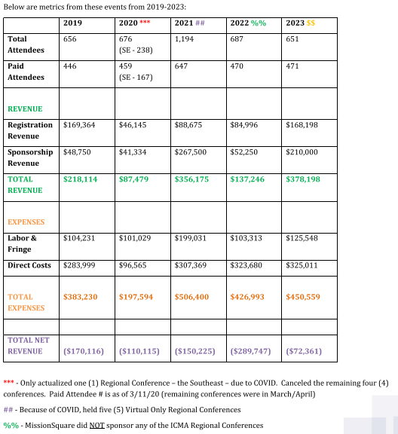
How AI is Reshaping the Landscape of Local Government
Boston, MA
April 10-12
Palm Desert, CA
June 5-7
Groups of 2 or more get 20% off
www.lgr.icma.org
Notes:
$31 million budget
21.5% revenues 6,665,000 avg
$158,000 loss .02%;
don’t like it, let us know

Slide 8
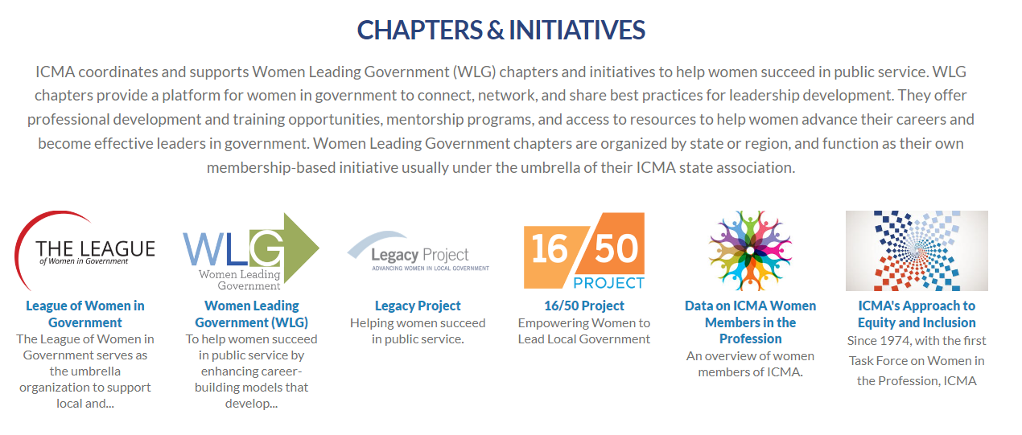
League of Women in Government
SheLeads

Slide 9
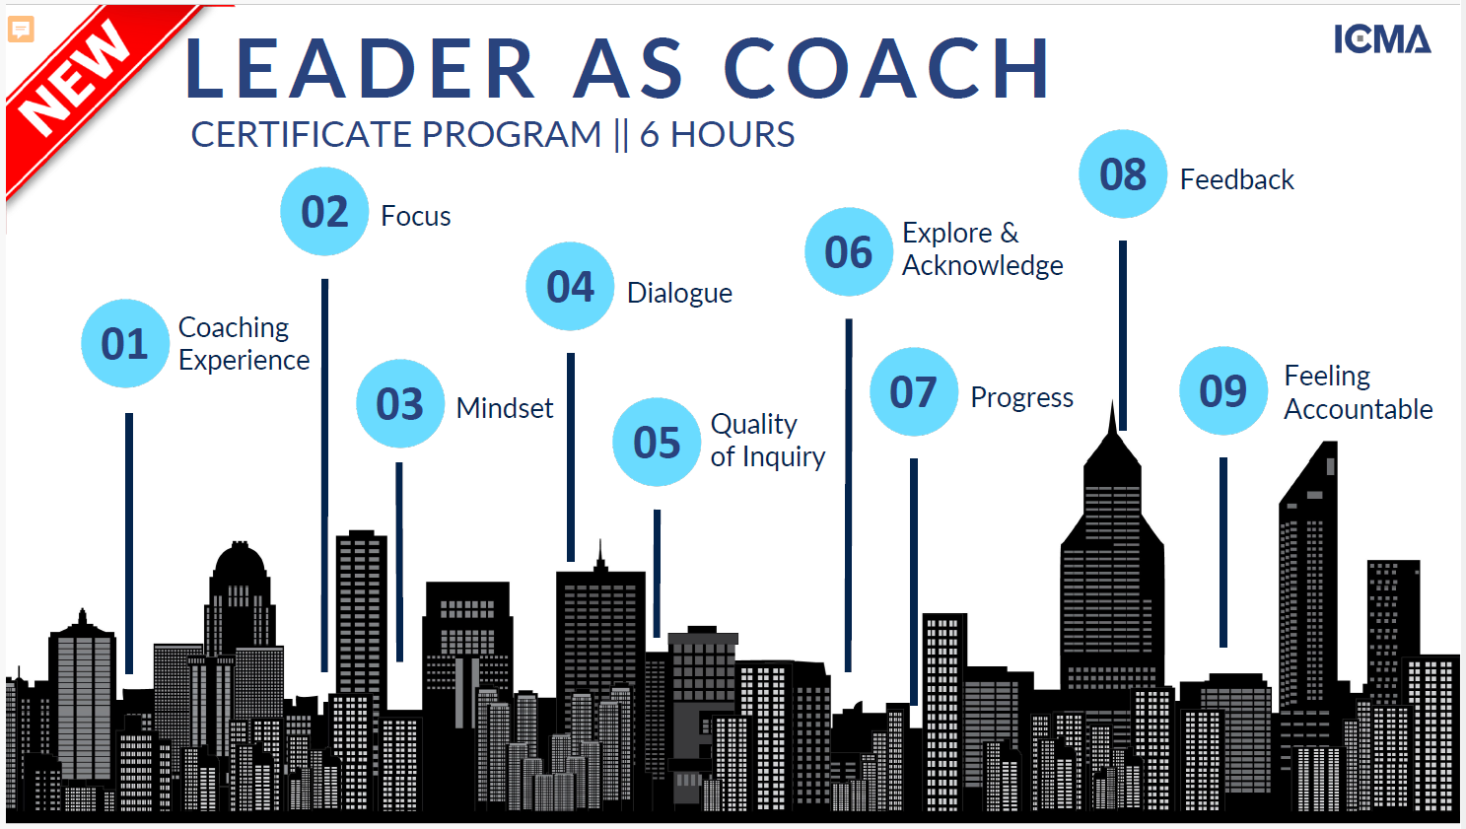

Slide 10
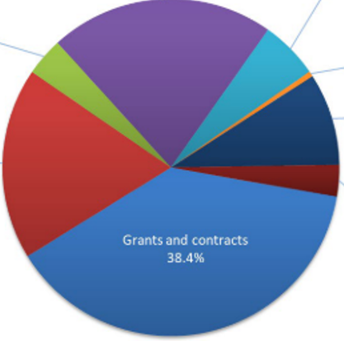
Notes:
38.4% is $12 million of $31 million budget

Slide 11
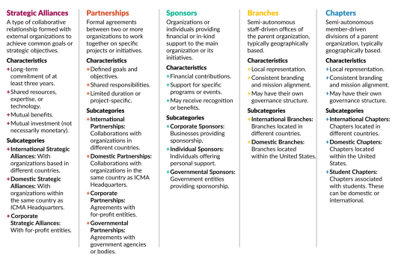

Slide 12
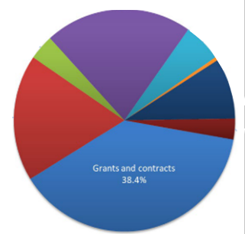

Slide 13
Mountain Plains Task Force Members:
Nick Hernandez Amanda Mack Gerald Hodges
Kansas South Dakota Texas

Slide 14
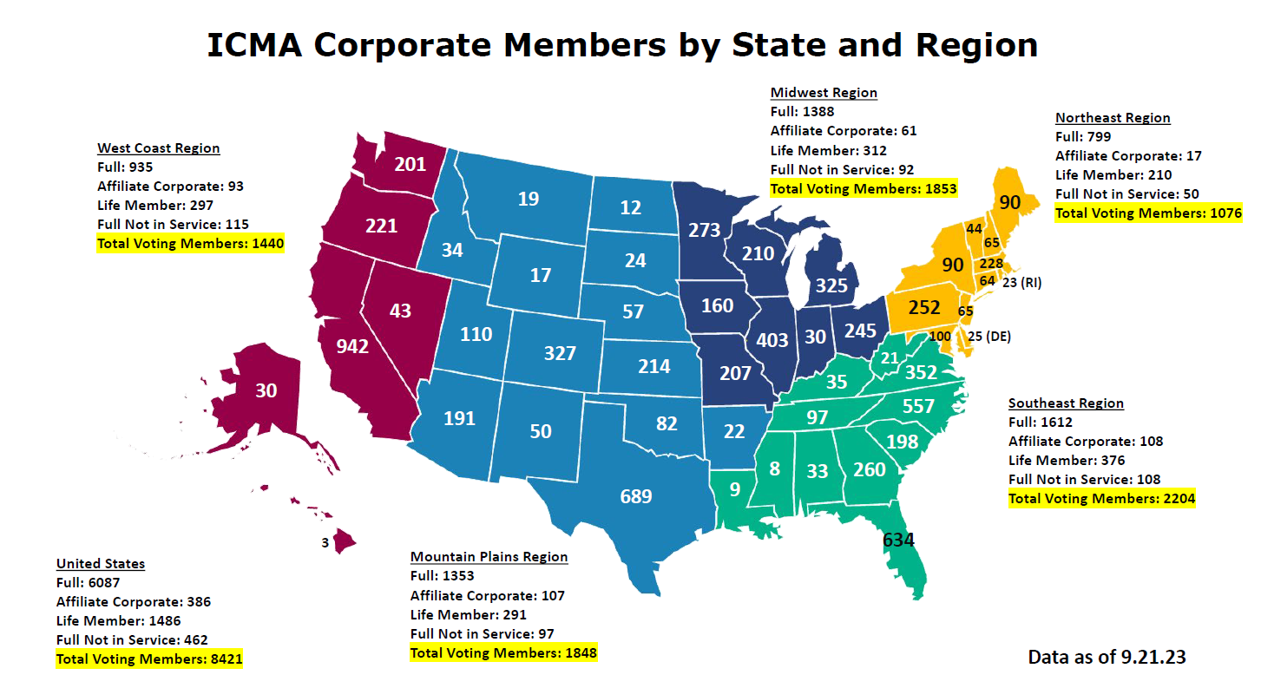

Slide 15
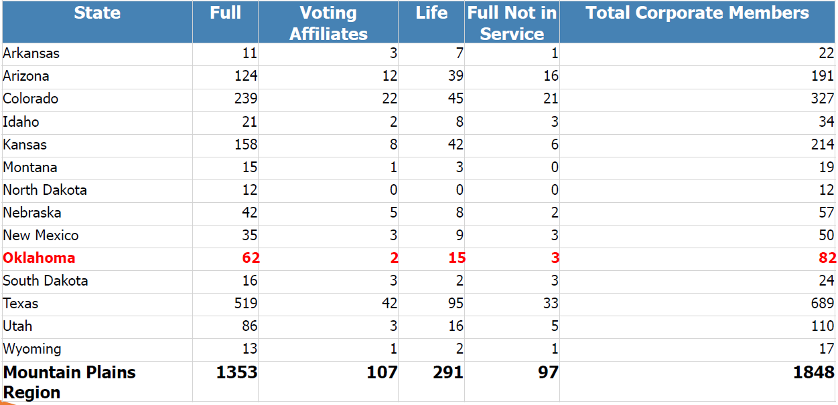

Slide 16
Notes:
CMAO members abide by the ICMA Code of Ethics
CMAO Application “I… ICMA Code of Ethics…”
Most State Affiliate Organizations use the ICMA Code of Ethics
ICMA developing ethics training for new members and annual renewals.

Slide 17
Notes:
Code turns 100 years old this year
Every year, 4 tenets are reviewed
Tenets and Guidelines

Slide 19
ICMA Code of Ethics with Guidelines
The ICMA Code of Ethics was adopted by the ICMA membership in 1924, and most recently amended by the membership in April 2023. The Guidelines for the Code were adopted by the ICMA Executive Board in 1972, and most recently revised in June 2023.
The mission of ICMA is to advance professional local government through leadership, management, innovation, and ethics. To further this mission, certain principles, as enforced by the Rules of Procedure, shall govern the conduct of every member of ICMA, who shall …
ICMA Ethics Staff Advisors
Self Reporting
Process of Ethics Complaint
Tenets and Guidelines
Upcoming Ethics Training for new members and renewals to review the Code of Ethics
Notes:
Don’t have any real good juicy stories.
Most ethic violations are boring without flair, and should have been avoided by following the tenets and guidelines
Guidelines added to provide clarity
How many people “Checked” the I read…Ethics box without reading them?
Martha Perego retired,

Slide 20
ICMA Ethics Activity
Year | 2023 | 2022 | 2021
Member Advice Inquiries | 135 | 160 | 212
Complaints Filed | 79 | 62 | N/A
Formal Review | 25 | 24 | N/A
Ethics Cases | 16 | 20 | 34
Public Censure and Expulsion | 0 | 2 | 2
Public Censure and Suspension | 0 | 0 | 2
Public Censure and ICMA-CM revoked | 1 | 2 | 2
Public Censure | 1 | 3 | 1
Private Censure | 7 | 9 | 13
Closed with or without action | 7 | 4 | 14
Ethic Cases by Tenet
 | Tenets
 | 2 | 3 | 7 | 9 | 11 | 12
2021 | 0 | 11 | 4 | 1 | 1 | 3
2022 | 1 | 13 | 3 | 0 | 0 | 0
2023 | 0 | 6 | 2 | 0 | 0 | 2
Total | 1 | 30 | 9 | 1 | 1 | 5
ICMA Ethics Annual Reports (by year): www.icma.org/page/enforcing-icma-code-ethics
ICMA Homepage → About ICMA → Ethics → Enforcing the ICMA Code of Ethics
Notes:
Why is our code of ethics so important?
We are constantly under the microscope as the “face of the community”

Slide 21
Tenet 1
We believe professional management is essential to effective, efficient, equitable, and democratic local government.
Notes:
Violate by being ineffective, inefficient inequitable or non-democratic

Slide 22
Tenet 2
Affirm the dignity and worth of local government services and maintain a deep sense of social responsibility as a trusted public servant.
GUIDELINE
Advice to Officials of Other Local Governments: When members advise and respond to inquiries from elected or appointed officials of other local governments, they should inform the administrators of those communities in order to uphold local government professionalism.
Notes:
Complaint about their manager/staff
How would you have handled….
We need help doing…
Saw y’all did this successfully, can you share….
Newly elected officials can be challenging
Share good information for all to succeed

Slide 23
Tenet 3
Demonstrate by word and action the highest standards of ethical conduct and integrity in all public, professional, and personal relationships in order that the member may merit the trust and respect of the elected and appointed officials, employees, and the public.
Notes:
Interpretive, not really
High number of complaints
12 Guidelines

Slide 24
Tenet 3 Guidelines
Public Confidence: Members should conduct themselves so as to maintain public confidence in their position and profession, the integrity of their local government, and in their responsibility to uphold the public trust.
Length of Service: For chief administrative/executive officers appointed by a governing body or elected official, a minimum of two years is considered necessary to render a professional service to the local government. In limited circumstances, it may be in the best interests of the local government and the member to separate before serving two years.
Some examples include refusal of the appointing authority to honor commitments concerning conditions of employment, a vote of no confidence in the member, or significant personal issues. It is the responsibility of an applicant for a position to understand conditions of employment, including expectations of service.
Not understanding the terms of employment prior to accepting does not justify premature separation. For all members a short tenure should be the exception rather than a recurring experience, and members are expected to honor all conditions of employment with the organization.
Notes:
Public confidence, not the 1% ers
Anyone in here hold a position for less than 2 years? As an ICMA Member?
If you’re miserable, and they don’t like you, find the limited circumstance (personal issue)
Not understanding, did you ask about it during the interview?
Was it readily available as information or truly hidden?

Slide 25
Tenet 3 Guidelines
Appointment Commitment: Members who accept an appointment to a position should report to that position. This does not preclude the possibility of a member considering several offers or seeking several positions at the same time. However, once a member has accepted a formal offer of employment, that commitment is considered binding unless the employer makes fundamental changes in the negotiated terms of employment.
Credentials: A member’s resume for employment or application for ICMA’s Voluntary Credentialing Program shall completely and accurately reflect the member’s education, work experience, and personal history. Omissions and inaccuracies must be avoided.
Notes:
Don’t accept a position that you are not ready to take.
If you are anticipating multiple offers, be honest
Ask for a reasonable amount of time to consider the offer to respond
Don’t use ICMA-CM if you’re not

Slide 26
Tenet 3 Guidelines
Professional Respect: Members seeking a position should show professional respect for persons formerly holding the position, successors holding the position, or for others who might be applying for the same position. Professional respect does not preclude honest differences of opinion; it does preclude attacking a person's motives or integrity.
Reporting Ethics Violations: When becoming aware of a possible violation of the ICMA Code of Ethics, members are encouraged to report possible violations to ICMA. In reporting the possible violation, members may choose to go on record as the complainant or report the matter on a confidential basis.
Confidentiality: Members shall not discuss or divulge information with anyone about pending or completed ethics cases, except as specifically authorized by the Rules of Procedure for Enforcement of the Code of Ethics.
Notes:
How do you want to be remembered when you leave?
Reporting options: Encourage them to self-report, if hearsay, advise the individual on how to report
Not sure why someone would want to divulge information

Slide 27
Tenet 3 Guidelines
Seeking Employment: Members should not seek employment for a position that has an incumbent who has not announced his or her separation or been officially informed by the appointive entity that his or her services are to be terminated. Members should not initiate contact with representatives of the appointive entity. Members contacted by representatives of the appointive entity body regarding prospective interest in the position should decline to have a conversation until the incumbent's separation from employment is publicly known.
Relationships in the Workplace: Members should not engage in an intimate or romantic relationship with any elected official or board appointee, employee they report to, one they appoint and/or supervise, either directly or indirectly, within the organization. This guideline does not restrict personal friendships, professional mentoring, or social interactions with employees, elected officials and Board appointees.
Influence: Members should conduct their professional and personal affairs in a manner that demonstrates that they cannot be improperly influenced in the performance of their official duties.
Notes:
Some councils want someone on deck before holding the axe
Making contact vs receiving contact
Use of search firm
Pretty much covers every single coworker or person involved in the organization
But we were in different departments… But we are in love…
Dating apps
Be careful as “the new city manager”

Slide 28
Tenet 3 Guidelines
Conflicting Roles: Members who serve multiple roles – either within the local government organization or externally – should avoid participating in matters that create either a conflict of interest or the perception of one. They should disclose any potential conflict to the governing body so that it can be managed appropriately.
Conduct Unbecoming. Members should treat people fairly, with dignity and respect and should not engage in, or condone bullying behavior, harassment, sexual harassment or discrimination on the basis of race, religion, national origin, age, disability, gender, gender identity, or sexual orientation.
Notes:
CM-PWD-EDD-Airport Mgr Etc.
Water Board, OMAG, OML, CMAO, OMPA, GRDA, MESO, MCT, GFO, state or regional appointment etc
Gender identity added

Slide 29
Tenet 4
Serve the best interests of all community members.
GUIDELINES
Effects of Decisions: Members should inform the appropriate elected or appointed official(s) of a decision's anticipated effects on community members.
Promote Equity: Members should ensure fairness and impartiality in accessing programs and services and in the enforcement of laws and regulations. Members should assess and propose solutions to strive to eliminate disparities.
Notes:
Crystal ball fuzzy, try the magic 8 ball
Access to services
Eliminate Disparities

Slide 30
Tenet 5
Submit policy proposals to elected officials; provide them with facts, and technical and professional advice about policy options; and collaborate with them in setting goals for the community and organization.
Notes:
Personally or professionally…
“I think” verse “our research and data shows…”

Slide 31
Tenet 6
Recognize that elected representatives are accountable to their community for the decisions they make; members are responsible for implementing those decisions.
Notes:
Not up to our profession to hold elected officials accountable, even if the community opts not to, unless they are breaking the law
We implement their collective decision
Skilled in the arts of persuasion and negotiation

Slide 32
Tenet 7
Refrain from all political activities which undermine public confidence in professional administrators. Refrain from participation in the election of the members of the employing legislative body.
Notes:
Guidelines vs tenet
“employing legislative body-Part 2” vs “elected office-Part 1”
High violated tenet
7 guidelines

Slide 33
Tenet 7 Guidelines
Elections of the Governing Body: Members should maintain a reputation for serving equally and impartially all members of the governing body of the local government they serve, regardless of party. To this end, they should not participate in an election campaign on behalf of or in opposition to candidates for the governing body.
Elections of Elected Executives: Members shall not participate in the election campaign of any candidate for mayor or elected county executive.
Running for Office: Members shall not run for elected office or become involved in political activities related to running for elected office, or accept appointment to an elected office. They shall not seek political endorsements, financial contributions or engage in other campaign activities.
Notes:
I know you can’t say, but who should I vote for…
Do not run for any public elected office and stay out of campaigns
College buddy running for Sheriff in LeFlore County
Lt Timmie review my ad please

Slide 34
Tenet 7 Guidelines
Elections: Members share with their fellow citizens the right and responsibility to vote. However, in order not to impair their effectiveness on behalf of the local governments they serve, they shall not participate in political activities to support the candidacy of individuals running for any city, county, special district, school, state or federal offices. Specifically, they shall not endorse candidates, make financial contributions, sign or circulate petitions, or participate in fund-raising activities for individuals seeking or holding elected office.
Elections relating to the Form of Government: Members may assist in preparing and presenting materials that explain the form of government to the public prior to a form of government election. If assistance is required by another community, members may respond.
Notes:
LeFlore Timmie
Rep Sanders Mary Fallin

Slide 35
Tenet 7 Guidelines
Presentation of Issues: Members may assist their governing body in the presentation of issues involved in referenda such as bond issues, annexations, and other matters that affect the government entity’s operations and/or fiscal capacity.
Personal Advocacy of Issues: Members share with their fellow citizens the right and responsibility to voice their opinion on public issues. Members may advocate for issues of personal interest only when doing so does not conflict with the performance of their official duties.
Notes:
Sales tax vote yes… inform and educate, not vote yes or no
Advocacy issues, advise Council
Ivestor, Corn, Jones active in politics doesn’t make you a bad city manger, but limits your participation in and resources of professional associations.

Slide 36
Tenet 8
Make it a duty continually to improve the member’s professional ability and to develop the competence of associates in the use of management techniques.
GUIDELINES
Self-Assessment: Each member should assess his or her professional skills and abilities on a periodic basis.
Professional Development: Each member should commit at least 40 hours per year to professional development activities that are based on the practices identified by the members of ICMA.
Notes:
Sounds like of you’re not ICMA-CM or pursuing, you’re in violation of this tenet
Develop competence of associates

Slide 37
Tenet 9
Keep the community informed on local government affairs. Encourage and facilitate active engagement and constructive communication between community members and all local government officials.
GUIDELINE
Engagement: Members should ensure community members can actively engage with their local government as well as eliminate barriers and support involvement of the community in the governance process.
Notes:
Key term being constructive
Eliminate barriers (hearings)

Slide 38
Tenet 10
Resist any encroachment on professional responsibilities, believing the member should be free to carry out official policies without interference, and handle each problem without discrimination on the basis of principle and justice.
GUIDELINE
Information Sharing: The member should openly share information with the governing body while diligently carrying out the member’s responsibilities as set forth in the charter or enabling legislation.
Notes:
Bad news doesn’t get better with age
Randy/TJ
I will give you as much information as you would like, however until this matter is closed, I’m protecting you from a potential lawsuit…

Slide 39
Tenet 11
Manage all personnel matters with fairness and impartiality.
GUIDELINE
Diversity and Inclusion: It is the member’s responsibility to recruit, hire, promote, retain, train, and support a diverse workforce at all levels of the organization.

Slide 40
Tenet 12
Public office is a public trust. A member shall not leverage his or her position for personal gain or benefit.
Notes:
Wonder why this tenet is a top complaint source
7 guidelines
New members, leadership journey to transition from authority to responsibility, whole other session to share

Slide 41
Tenet 12 Guidelines
Gifts: Members shall not directly or indirectly solicit, accept or receive any gift if it could reasonably be perceived or inferred that the gift was intended to influence them in the performance of their official duties; or if the gift was intended to serve as a reward for any official action on their part.
The term “Gift” includes but is not limited to services, travel, meals, gift cards, tickets, or other entertainment or hospitality. Gifts of money or loans from persons other than the local government jurisdiction pursuant to normal employment practices are not acceptable.
Members should not accept any gift that could undermine public confidence. De minimus gifts may be accepted in circumstances that support the execution of the member’s official duties or serve a legitimate public purpose. In those cases, the member should determine a modest maximum dollar value based on guidance from the governing body or any applicable state or local law.
The guideline is not intended to apply to normal social practices, not associated with the member’s official duties, where gifts are exchanged among friends, associates and relatives.
Notes:
Bid Solicitations, RFQs, vendors, service providers
OGE Thunder suite; XYZ Benefits Solutions OU tickets on the 50; 123 Engineering OSU Intergallactic Ping Pong Championship match with back stage passes
To prevent potential conflicts, I’ll just go ahead and take all Friday’s raffle prizes for safekeeping…

Slide 42
Tenet 12 Guidelines
Investments in Conflict with Official Duties: Members should refrain from any investment activity which would compromise the impartial and objective performance of their duties. Members should not invest or hold any investment, directly or indirectly, in any financial business, commercial, or other private transaction that creates a conflict of interest, in fact or appearance, with their official duties.
In the case of real estate, the use of confidential information and knowledge to further a member’s personal interest is not permitted. Purchases and sales which might be interpreted as speculation for quick profit should be avoided (see the guideline on “Confidential Information”). Because personal investments may appear to influence official actions and decisions, or create the appearance of impropriety, members should disclose or dispose of such investments prior to accepting a position in a local government. Should the conflict of interest arise during employment, the member should make full disclosure and/or recuse themselves prior to any official action by the governing body that may affect such investments.
This guideline is not intended to prohibit a member from having or acquiring an interest in or deriving a benefit from any investment when the interest or benefit is due to ownership by the member or the member’s family of a de minimus percentage of a corporation traded on a recognized stock exchange even though the corporation or its subsidiaries may do business with the local government.
Notes:
Own a business prior to CM, and city wants to use it.
Partner/Spouse’s business (realtor/commercial broker)
Personal gain Buy low, sell high
Can own stock

Slide 43
Tenet 12 Guidelines
Personal Relationships: In any instance where there is a conflict of interest, appearance of a conflict of interest, or personal financial gain of a member by virtue of a relationship with any individual, spouse/partner, group, agency, vendor or other entity, the member shall disclose the relationship to the organization. For example, if the member has a relative that works for a developer doing business with the local government, that fact should be disclosed.
Confidential Information: Members shall not disclose to others, or use to advance their personal interest, intellectual property, confidential information, or information that is not yet public knowledge, that has been acquired by them in the course of their official duties. Information that may be in the public domain or accessible by means of an open records request, is not confidential.
Private Employment: Members should not engage in, solicit, negotiate for, or promise to accept private employment, nor should they render services for private interests or conduct a private business when such employment, service, or business creates a conflict with or impairs the proper discharge of their official duties. Teaching, lecturing, writing, or consulting are typical activities that may not involve conflict of interest, or impair the proper discharge of their official duties. Prior notification of the appointing authority is appropriate in all cases of outside employment.
Notes:
If there is a personal relationship, disclose it
If you have a side hustle, visit with your council
NPO work and grant

Slide 44
Tenet 12 Guidelines
Representation: Members should not represent any outside interest before any agency, whether public or private, except with the authorization of or at the direction of the appointing authority they serve.
Endorsements: Members should not endorse commercial products or services by agreeing to use their photograph, endorsement, or quotation in paid or other commercial advertisements, marketing materials, social media, or other documents, whether the member is compensated or not for the member’s support. Members may, however, provide verbal professional references as part of the due diligence phase of competitive process or in response to a direct inquiry.
Members may agree to endorse the following, provided they do not receive any compensation: (1) books or other publications; (2) professional development or educational services provided by nonprofit membership organizations or recognized educational institutions; (3) products and/or services in which the local government has a direct economic interest.
Members’ observations, opinions, and analyses of commercial products used or tested by their local governments are appropriate and useful to the profession when included as part of professional articles and reports.
Notes:
No NIL but think we invented the transfer portal

Slide 45
ICMA Ethics Enforcement 2023
Committee on Professional Conduct (CPC) received 79 Ethics Complaints in 2023
16 Ethics Case Reviews completed
1 public censure with revocation of Credentialed Manager status
1 public censure
7 private censures
7 closed with or without advice
22 Ethics Cases Pending
ICMA Ethics Staff (202) 962-3513
Jessica Cowles ICMA Ethics Director jcowles@icma.org
Camilla Posthill ICMA Ethics Senior Program Manager cposthill@icma.org

Slide 46
Dave Slezickey
405-368-3705
dave@thevillageok.gov dslezickey@icma.org

