Slide 1
CMAO Winter Conference
January 24, 2024

Slide 2
Leading through trying times of Political and Economic unknowns
Two different environments
Two different challenges for City Managers
Let’s compare and contrast the approach to these to situations
Economic unknowns best approached “offensively”
Political unknowns best approached “defensively”

Slide 3
Would you rather:
Have you ever played the game?
Would you rather face economic unknowns during times of political stability, or political unknowns in times of economic stability?

Slide 4
Answer
Economic unknowns with a stable political environment.

Slide 5
Why?
Of the two environments, times of Economic unknowns are far more predictable (and survivable) than Political unknowns

Slide 6
Leading through trying times of Economic unknowns
Examples:
Housing crash of 2008
Pandemic of 2020
Local economic unknowns are most likely symptoms of National economic unknowns
Typically, economic cycles run between 4 and 7 years of up and down (wave cycle)

Slide 7
Leading through trying times of Economic unknowns
Processes and communications vehicles are an absolute necessity
Transparency is a must
If you implement such practices in times of Economic stability, you develop trust in the message and the messenger when things get dark and murky

Slide 8
Leading through trying times of Economic unknowns
When in the fiscal year does the picture become murky?
Budget Development
Mid-Year
Or late in the 4th Quarter

Slide 9
Leading through trying times of Economic unknowns
During Budget Development
What are you seeing that raises concern?
What are your budget managers seeing?
What are your neighboring agencies seeing?
What does the State look like?
What do you see Nationally and Globally?

Slide 10
Leading through trying times of Economic unknowns
“Past performance is not a guarantee of future performance!”
Meet regularly with your elected officials throughout the budget development process
How do you ensure such interaction takes place?

Slide 11
Leading through trying times of Economic unknowns
Do you publish a Budget Calendar?

Slide 12
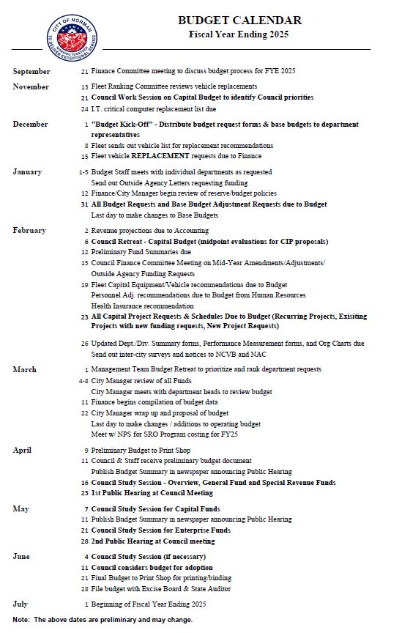

Slide 13
Leading through trying times of Economic unknowns
Share your projections and the sources of information that lead you to there
“If you see (or feel) something, say something”
Remember, being wrong in a projection is not a fatal error. Keeping it a secrete until the checks bounce is….

Slide 14
Leading through trying times of Economic unknowns
These are your opportunities to manage expectations
Not just with your elected officials, but the community and the bargaining units with whom you may have to meet and confer

Slide 15
Leading through trying times of Economic unknowns
Mid-Year
What are you seeing that raises concern?
What are your budget managers seeing?
What are your neighboring agencies seeing?
What does the State look like?
What do you see Nationally and Globally?

Slide 16
Leading through trying times of Economic unknowns
Mid-Year
Is it time to sound the alarm?
Do you have Reserve Policies for Economic Uncertainty?
What other strategies might be employed to recover from the unknown?
If you do not have such polices, reserves, and strategies, then now is the time to develop them

Slide 17
Leading through trying times of Economic unknowns
Late in the 4th Quarter
What are you seeing that raises concern?
What are your budget managers seeing?
What are your neighboring agencies seeing?
What does the State look like?
What do you see Nationally and Globally?

Slide 18
Leading through trying times of Economic unknowns
Late in the 4th Quarter
Typically at this stage of the fiscal year, the focus needs to be on how this realization will impact the budget you spent months developing.
Budget adoption is NOT an option.
11 Okla.Stat.s. 17-201 thru 17-216

Slide 19
Leading through trying times of Economic unknowns
Late in the 4th Quarter
Adopt what you have presented, then schedule a follow-up meeting to amend
Adopt an amended resolution reflecting changes you feel comfortable making almost on the fly

Slide 20
Leading through trying times of Political unknowns
The cycle of Political unknowns seems to happen far more frequently than Economic unknowns
The science of leadership in the Economic unknown vs. the art of leadership in the Political unknown

Slide 21
Leading through trying times of Political unknowns
What is your election cycle? This may equal the wave cycle for Political unknowns
Elections and the campaign cycle are known as “The Silly Season”
Managing expectations is a near impossibility
There is no “Reserve for Political uncertainty”

Slide 22
Leading through trying times of Political unknowns
Examples:
Political dynamics change with each new member on your Council
The more Council Members you have, the greater the volatility with each changing seat

Slide 23
Leading through trying times of Political unknowns
Strategies shared in both environments
Transparency is a must. This is necessary to prevent staff (City Managers) from becoming cannon fodder
Operate from a position of fact. You have the source documents of the truth. Share them
Maintain the professional high ground
Treat everyone in the environment the same

Slide 24
Leading through trying times of Political unknowns
Do not let political unknowns move you from your ethical foundation
Situational awareness can help you lead your Management TEAM through the minefield of political agendas
Without leadership here, the voice of one politician can spread doubt on the soundness of staff actions

Slide 25
Leading through trying times of Political unknowns
Since the breadth of Political unknowns spans so much more than the financial future of the organization, the ability to rely on your reputation and past successes help Managers survive
Usually those creating political chaos don’t last in that capacity.
The defensive approach may be best described as winning by attrition. Your ability to outlast the chaos is a win

Slide 26
Leading through trying times of Political and Economic unknowns
Let’s play the game again.
Would you rather?
Who can you rely on?
Who can you call on for help?
Don’t let political issues fester. Address them professionally, with facts and transparency
Don’t let economic unknowns grow in darkness. Bring those items to light, publically, and early

Slide 27
Leading through trying times of Political and Economic unknowns
Let’s chat!

